Slide 1
Open RAN

Slide 2
Outline
Weekly report
Summary of this week’s work
Your work
Conclusion
Your opinion/thought
Action item

Slide 3
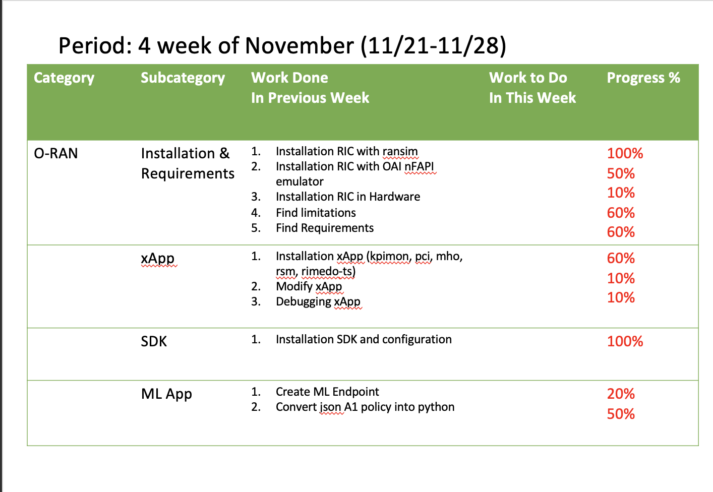
Weekly report

Slide 4
Summary of work this week
Explore implementation of ML on SD-RAN

Slide 5
Question to be Answered
How communication between RT-RIC and xApp?
How to integrate ML into xApp?

Slide 6
Your work
New Capabilities of RAN Simulator
Load dataset from custom CSV, steps:
Provide custom csv
Customize measurement type name
Build the image
Customize helm chart with custom image
Published yesterday

Slide 7
Your work
SD-RAN Protocol and Disaggregation Component
Understanding gRPC and REST in SD-RAN
Explore service model provided by onos-e2-sm
KPM (Key Performance Measurement)
Communication of xApp and other component

Slide 8
Your work
Integrate Golang with ML
Explore Golang capabilities with ML library, such as gota dataframe
Explore Golang capabilities to integrate with Tensorflow ML Framework using Go bindings

Slide 9
Your work
Technical Issues of Development
No available public example of ML implementation based on SD-RAN. RimedoLabs provide course training about ML xApp development.
Can’t intercept bidirectional communication between component from local xApp with component inside Kubernetes cluster.
SD-RAN only provide scripts for clean Ubuntu machine OS for LTE traffic use case.

Slide 10
Conclusion
Communication RT-RIC between nRT-RIC depends on E2-SM. The xApp needs to make subscription into E2T to retrieve the data.
Integration xApp SDK with Tensorflow is possible using Go bindings.
The RimedoLabs Training can help to develop and solve technical issues.

Slide 11
Your opinion/thought
Course Training required to help develop xApp.
Exploration of integration xApp and ML still needed

Slide 12
Action items
Test new RAN Simulator capabilities
Find the solution to solve technical issues

